Slide 1
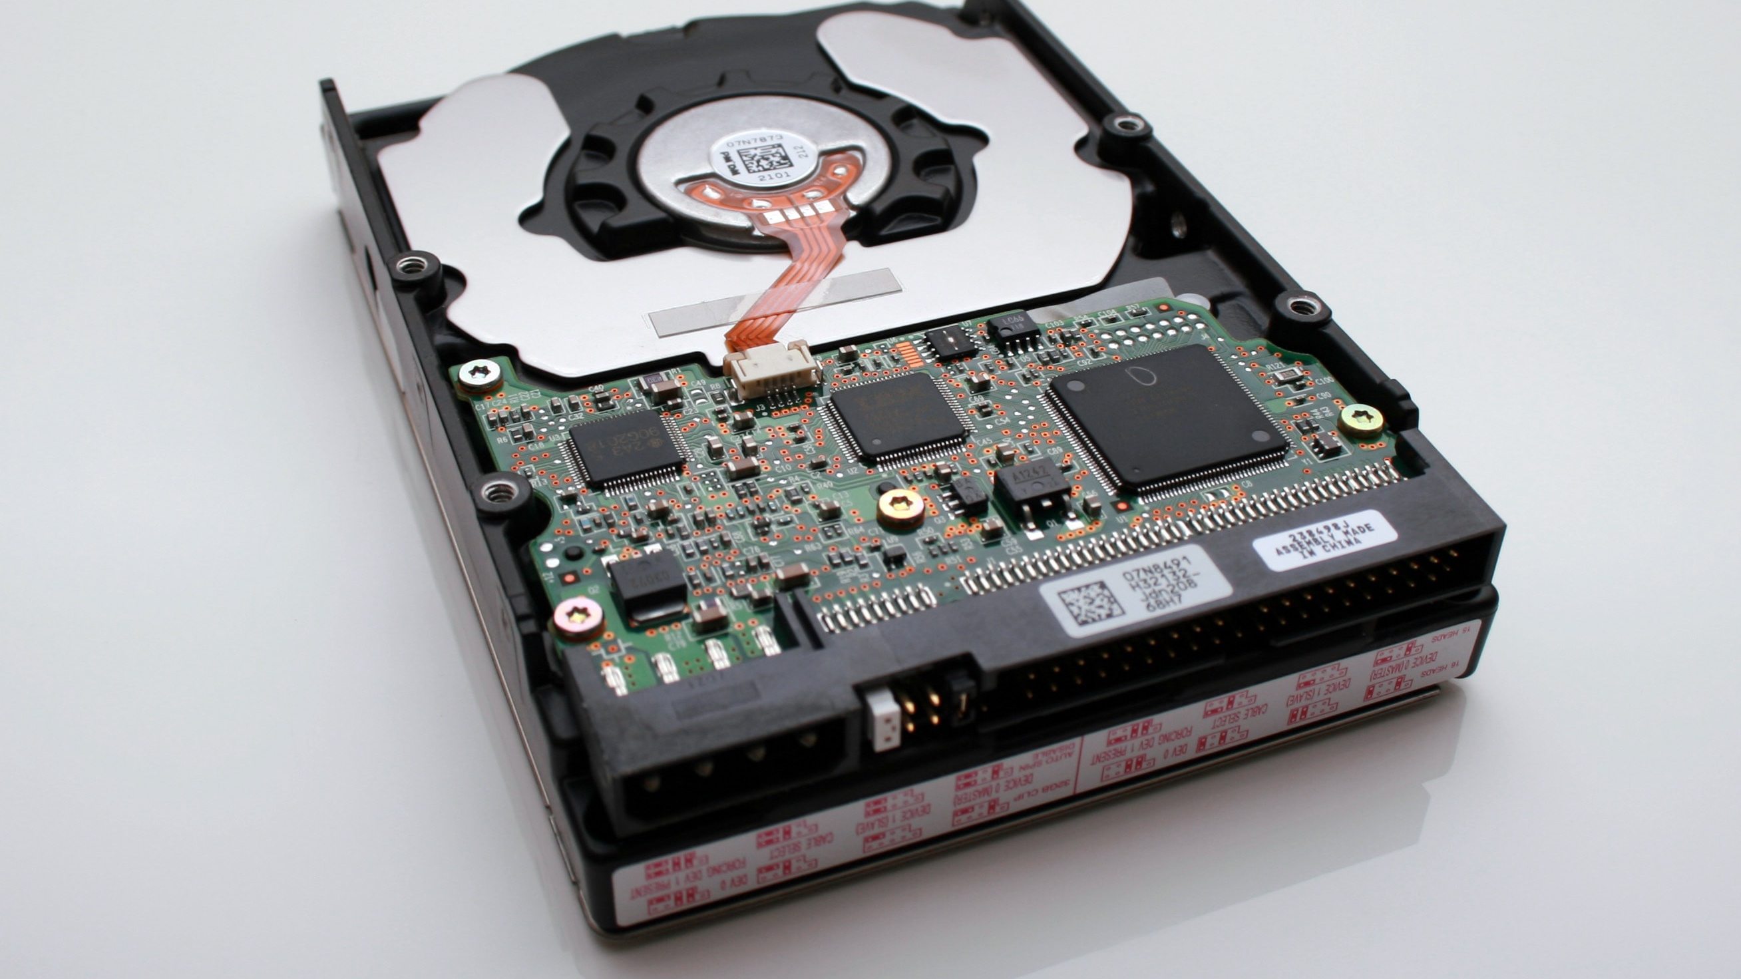
Java In Container
Mateusz Dymiński

Slide 2
whoami
Mateusz Dymiński
Software Developer at Nokia
8+ exp with Java
5+ exp with Go
One of the organizer GoWroc - Golang Wroclaw Meetup
Page: mateuszdyminski.com
Github: github.com/mateuszdyminski
Twitter: @m_dyminski
LinkedIn: linkedin.com/in/mdyminski

Slide 3
Agenda
Demo app
Signaling in containers
Choosing container base image
Layering demo app
Multistage builds
Java Ergonomics
Security
Google JIB
Extras
Summary

Slide 4

github.com/mateuszdyminski/java-in-container

Slide 5

Let’s Build Application

Slide 6
Users Application
Users Service
REST API
Storage: MySQL

Slide 7
User
@Entity @Table(name = "users") public class User { @Id @GeneratedValue(strategy = GenerationType.IDENTITY) private Integer id; private String firstName; private String secondName; @Temporal(TemporalType.TIMESTAMP) private Date birthDate; public Integer getId() { return id; } public String getFirstName() { return firstName; } public String getSecondName() { return secondName; } public Date getBirthDate() { return birthDate; } }

Slide 8
Users Controller
@RestController @RequestMapping("/api") public class UsersController { @Autowired UserRepository userRepository; @GetMapping("/users") public List<User> getAllUsers() { return userRepository.findAll(); } @PostMapping("/users") public User createUser(@Valid @RequestBody User user) { return userRepository.save(user); } @GetMapping("/users/{id}") public User getUserById(@PathVariable(value = "id") Integer userId) { return userRepository.findById(userId) .orElseThrow(() -> new ResourceNotFoundException("User", "id", userId)); } }

Slide 9
Users Controller
@RestController @RequestMapping("/api") public class UsersController { @Autowired UserRepository userRepository; @GetMapping("/users") public List<User> getAllUsers() { return userRepository.findAll(); } @PostMapping("/users") public User createUser(@Valid @RequestBody User user) { return userRepository.save(user); } @GetMapping("/users/{id}") public User getUserById(@PathVariable(value = "id") Integer userId) { return userRepository.findById(userId) .orElseThrow(() -> new ResourceNotFoundException("User", "id", userId)); } }

Slide 10
Demo Users Service
Build Users Service
Run
Open
$ mvn package
$ java -jar target/users-app-1.0.jar
http://localhost:8080/api/users

Slide 11
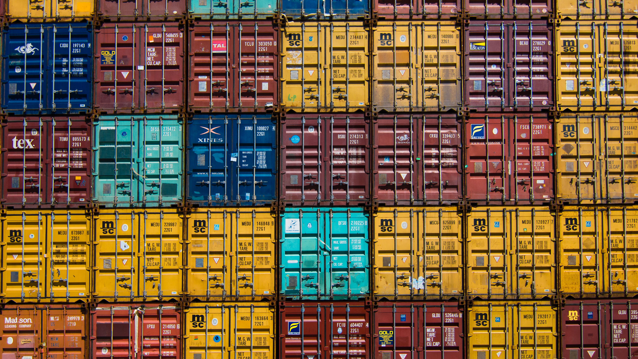
Let’s Dockerize Users App

Slide 12
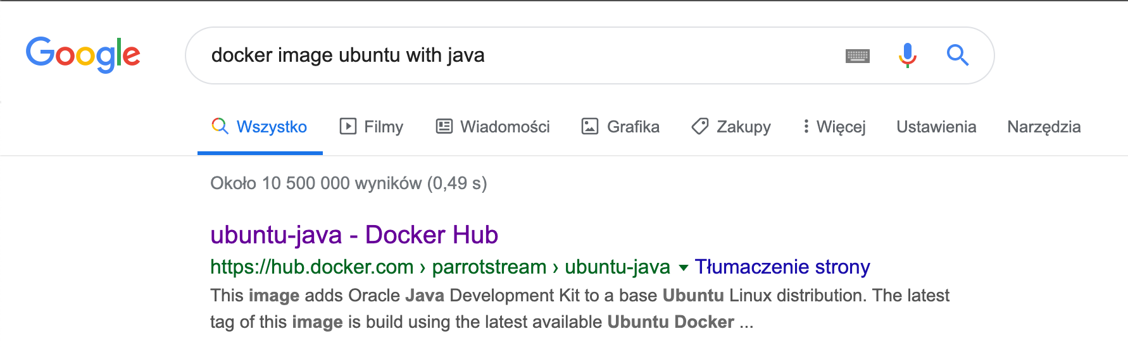

Slide 13
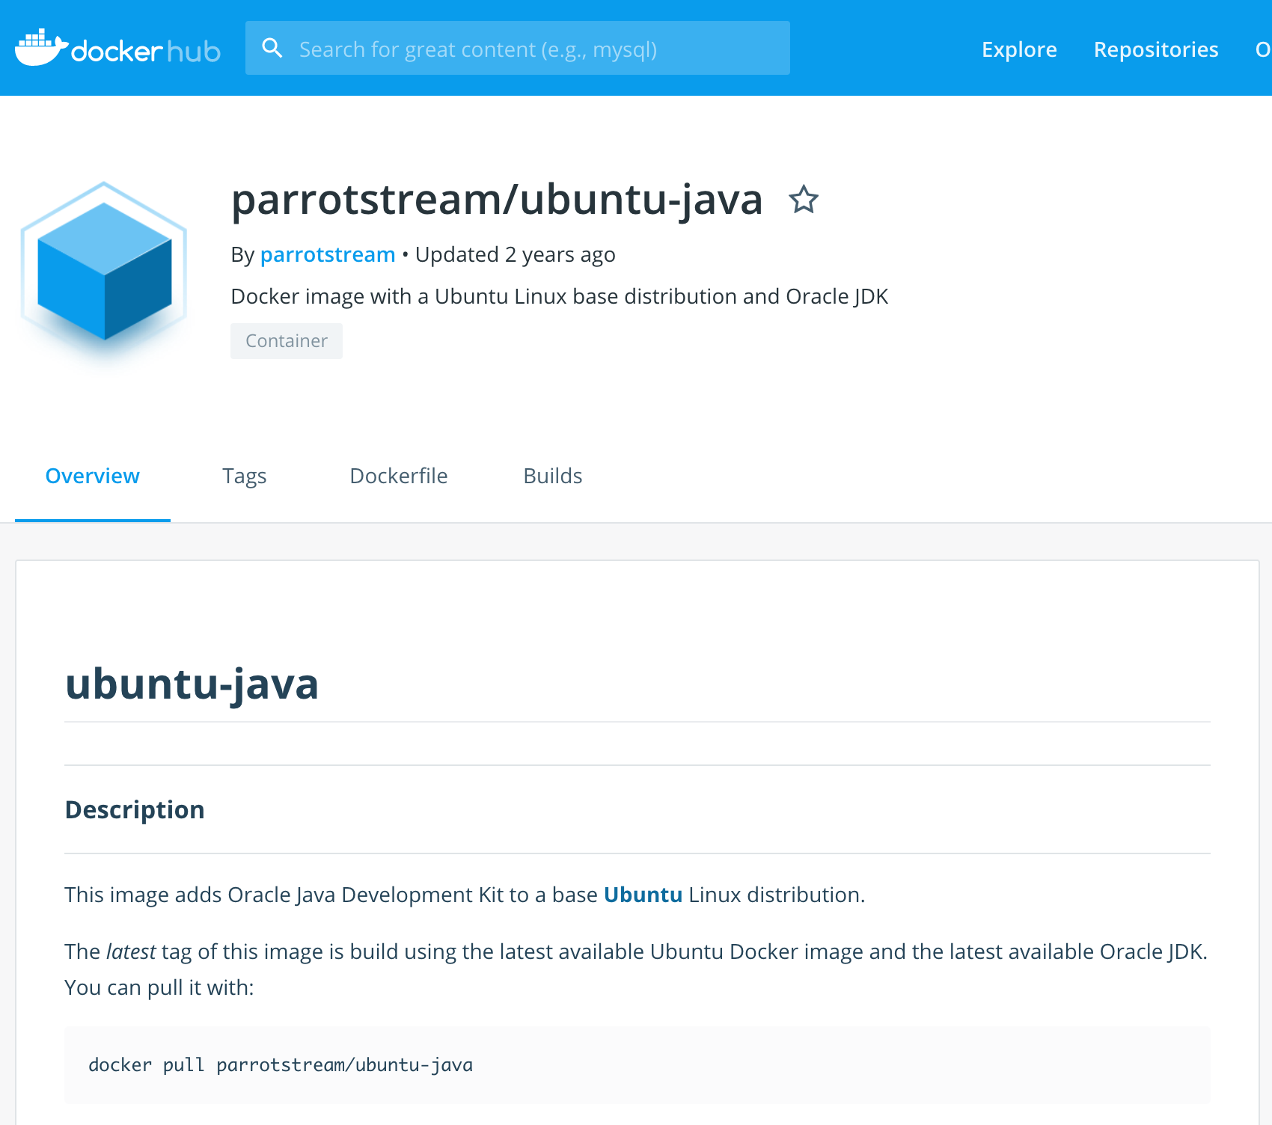

Slide 14
Our very first Dockerfile
FROM parrotstream/ubuntu-java
RUN mkdir -p /var/users-app
COPY target/users-app-1.0.jar /var/users-app/users-app-1.0.jar
COPY run.sh /var/users-app/run.sh
ENTRYPOINT "/var/users-app/run.sh"
And run.sh
#!/usr/bin/env sh
echo "Running users App" /usr/lib/jvm/java-8-oracle/bin/java -jar /var/users-app/users-app-1.0.jar

Slide 15

Let’s get ready for rumble!

Slide 16
Signaling – Entrypoint
We have 2 options while creating ENTRYPOINT:
or different exec where command line is like JSON array:
Long story short: always use the array exec form. The shell form runs your entrypoint as a subcommand of /bin/sh -c which comes with a load of problems, one of them notably that you’ll never see a signal in your application.
ENTRYPOINT "/usr/bin/java -jar /var/users-app/app-1.0.jar"
ENTRYPOINT ["java”, „-jar”, ”/var/users-app/app-1.0.jar”]

Slide 17
Signaling – Script as Entrypoint
Some applications are not suited to be run in ENTRYPOINT and require some logic before they can be started
Use exec - Instead of forking a new process from the existing bash it replaces the shell
Use:
Instead of:
exec /app/bin/your-app
/app/bin/your-app

Slide 18
Signaling part - summary
Use the exec/JSON array form of ENTRYPOINT.
Use exec in shell entrypoints.
Don’t pipe your application’s output.
Avoid being PID 1.
Listen for SIGTERM or set STOPSIGNAL in your Dockerfile.

Slide 19
Our Dockerfile v2
FROM parrotstream/ubuntu-java
RUN mkdir -p /var/users-app
COPY target/users-app-1.0.jar /var/users-app/users-app-1.0.jar
ENTRYPOINT ["/usr/lib/jvm/java-8-oracle/bin/java", "-XshowSettings:VM", "-XX:NativeMemoryTracking=summary", "-jar", "/var/users-app/users-app-1.0.jar"]

Slide 20
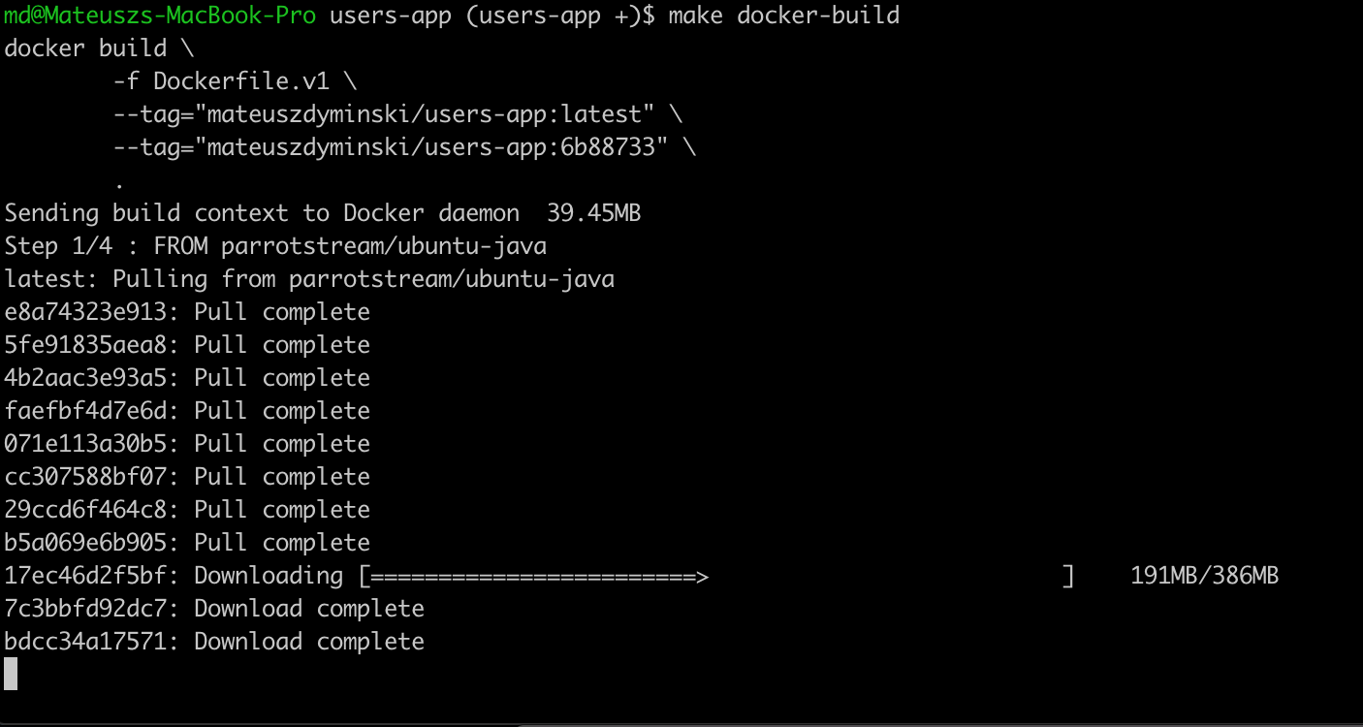


Slide 21
Checking image size
It’s 881mb !!!!!!!!!!!!!!!!!!!!!!!!!!!!!!!!

Slide 22

Choosing Container Base Image

Slide 23
First problem: Your Java Runtime
Oracle JDK
OpenJDK builds by Oracle
AdoptOpenJDK builds
AdoptOpenJDK OpenJ9 builds
Linux (Red Hat, Debian, Fedora, Arch, Ubuntu) OpenJDK builds
Azul Zulu
Amazon Corretto
SAP SapMachine
Liberica from Bellsoft

Slide 24
Second problem: Base Linux Image
Decision is based on Java Runtime
Do we rely on external OS toolbox? curl, wget, etc.
Do we really care about the size of image?
Security!
We need to choose distro which is free from CVE
Less components that can be exploited and smaller attack surface

Slide 25
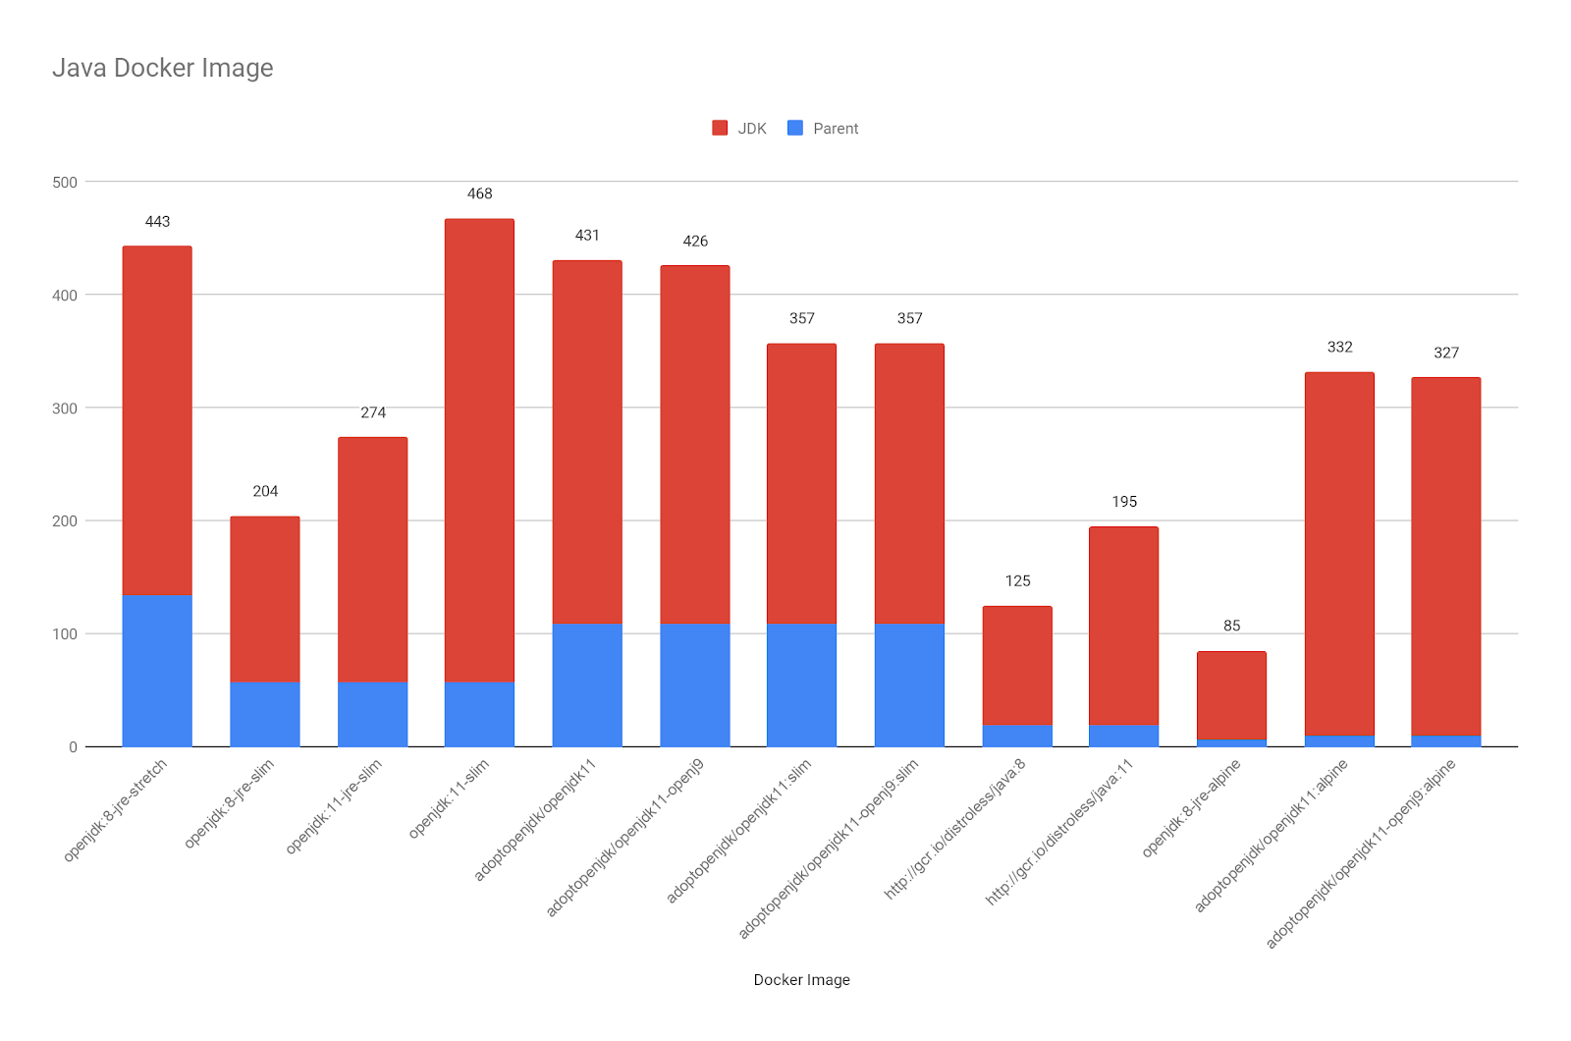

Slide 26

Let’s get Alpine then

Slide 27
Alpine
Lightweight Linux distribution based on musl libc and busybox
musl is a “libc”, an implementation of the standard library functionality described in the ISO C and POSIX standards
musl is a new general-purpose implementation of the C library. It is lightweight, fast, simple, free, and aims to be correct in the sense of standards-conformance and safety.
is basically the standardized interface between the kernel and userland

Slide 28
Project Partola
OpenJDK repository contains of many C/C++ code (around 19%)
The JVM has been already ported to glibc
But in order to ensure a transparent run of the JVM (and its C/C++ code) on musl, an effort should be made to port the JVM to it as well.
This is the goal of OpenJDK “Project Portola” is available as part of java 13.
It still in experimental status, needs more hardening and no GA is available for the moment.

Slide 29
Our Dockerfile 3
FROM openjdk:8-jre-alpine
RUN mkdir -p /var/users-app
COPY target/users-app-1.0.jar /var/users-app/users-app-1.0.jar
ENTRYPOINT ["java", "-XshowSettings:VM", "-XX:NativeMemoryTracking=summary", "-jar", "/var/users-app/users-app-1.0.jar"]

Slide 30
Checking image size
It’s 124mb !!!!!!!!!!!!!!!!!!!!!!!!!!!!!!!!
Was 881mb

Slide 31
Other options to make image smaller
Java
Java Modularity
Code refactoring
Dependencies
Docker
Smaller base image
Layers & Caching (dockerfilelint)
Dockerignore (faster builds)
Multistage Build
docker-squash

Slide 32

Let’s change business logic

Slide 33
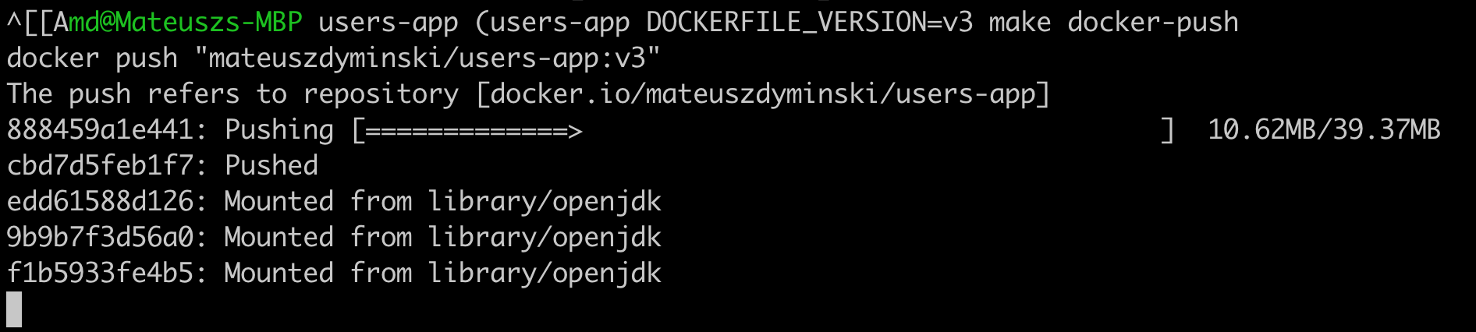
Problem:

Slide 34
Solution: Unpack Fat JAR
Build Users Service
Unpack JAR to create external and internal deps:
$ mvn clean package
$ mkdir target/dependency
$ (cd target/dependency; tar -zxf ../*.jar)

Slide 35
Our Dockerfile 4
FROM openjdk:8-jre-alpine
RUN mkdir -p /var/users-app
COPY target/dependency/BOOT-INF/lib /var/users-app/lib
COPY target/dependency/META-INF /var/users-app/META-INF
COPY target/dependency/BOOT-INF/classes /var/users-app
ENTRYPOINT [ "java", \
"-XshowSettings:VM", \
"-XX:NativeMemoryTracking=summary", \
"-cp", "/var/users-app:/var/users-app/lib/*", \
"com.example.users.UsersApp"]

Slide 36
Pros of Unpacking JAR
Really fast Docker builds
Only real changes are send over the network to Registry
Less space are ocupied both on Local machine and Registry

Slide 37
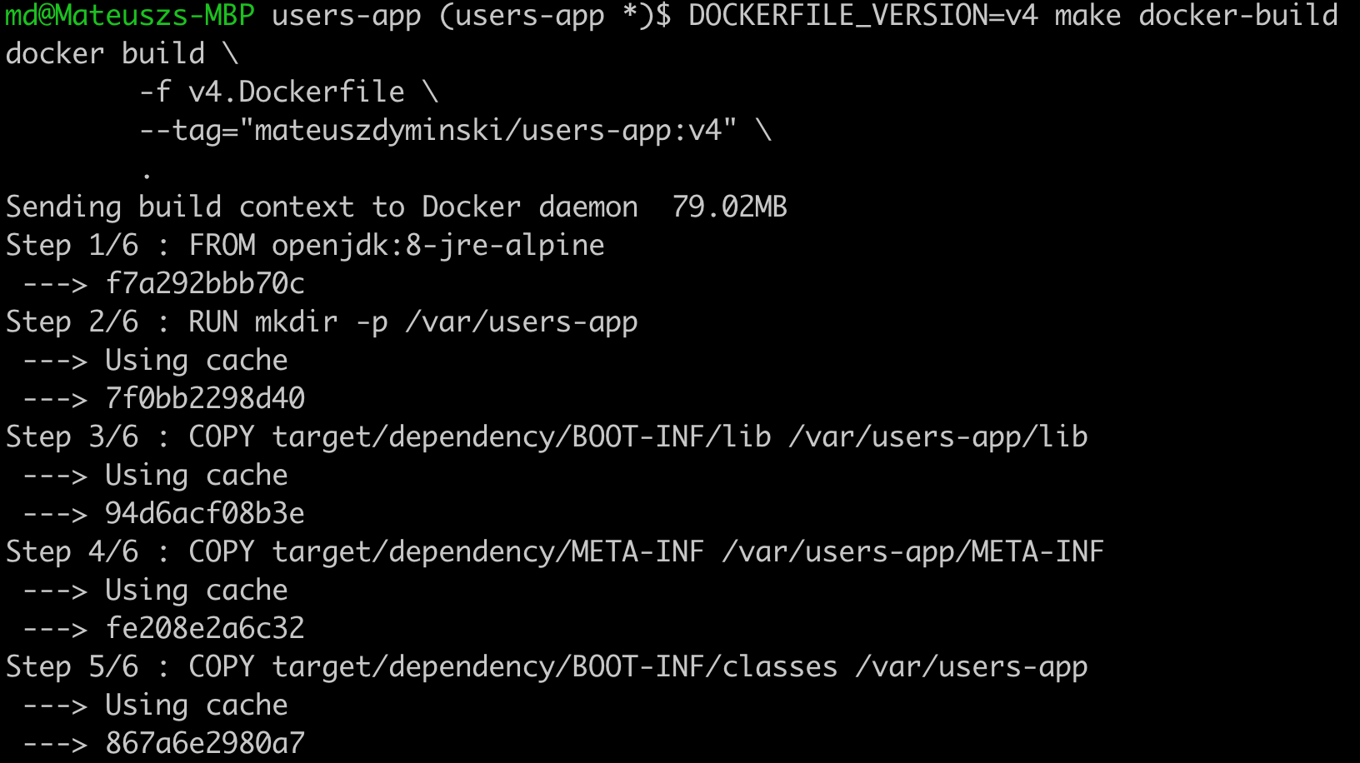

Another Problem(s)
We need to build out Java App on our local machine

Slide 38
Solution: Multistage Builds
FROM openjdk:8-jdk-alpine as build
WORKDIR /workspace/users-app
COPY mvnw .
COPY .mvn .mvn
COPY pom.xml .
COPY src src
RUN ./mvnw install -DskipTests
RUN mkdir -p target/dependency && (cd target/dependency; jar -xf ../*.jar)
FROM openjdk:8-jre-alpine
RUN mkdir -p /var/users-app ARG DEPENDENCY=/workspace/users-app/target/dependency COPY --from=build ${DEPENDENCY}/BOOT-INF/lib /var/users-app/lib
COPY --from=build ${DEPENDENCY}/META-INF /var/users-app/META-INF
COPY --from=build ${DEPENDENCY}/BOOT-INF/classes /var/users-app
ENTRYPOINT [ "java", \
"-XshowSettings:VM", \
"-XX:NativeMemoryTracking=summary", \
"-cp", "/var/users-app:/var/users-app/lib/*", \
"com.example.users.UsersApp"]
BUILD
Run

Slide 39
Pros of Unpacking JAR
We don’t need to send all deps to docker proces only src
All deps are cached by Docker
Builds are reproducible and they do not depends on VM where build phase is run

Slide 40

Java Ergonomics

Slide 41
Java Ergonomics
The JVM has plenty of ergonomics which are based on the underlying system
Memory
CPUs
Exact CPU model
Garbage collector
JIT Optimizations
Your friends:
-XX:+PrintFlagsFinal
-XX:+PrintGCDetails
-XshowSettings:VM
-XX:NativeMemoryTracking=summary

Slide 42
Java 8u121 and before

Slide 43

There is a hope…

Slide 44
Fabric8
# Based on the cgroup limits, figure out the max number of core we should utilize
core_limit() {
local cpu_period_file="/sys/fs/cgroup/cpu/cpu.cfs_period_us"
local cpu_quota_file="/sys/fs/cgroup/cpu/cpu.cfs_quota_us"
if [ -r "${cpu_period_file}" ]; then
local cpu_period="$(cat ${cpu_period_file})"
if [ -r "${cpu_quota_file}" ]; then
local cpu_quota="$(cat ${cpu_quota_file})"
# cfs_quota_us == -1 --> no restrictions
if [ ${cpu_quota:-0} -ne -1 ]; then
echo $(calc 'ceil($1/$2)' "${cpu_quota}" "${cpu_period}")
fi
fi
fi
}
max_memory() {
# High number which is the max limit until which memory is supposed to be
# unbounded.
local mem_file="/sys/fs/cgroup/memory/memory.limit_in_bytes"
if [ -r "${mem_file}" ]; then
local max_mem_cgroup="$(cat ${mem_file})"
local max_mem_meminfo_kb="$(cat /proc/meminfo | awk '/MemTotal/ {print $2}')"
local max_mem_meminfo="$(expr $max_mem_meminfo_kb \* 1024)"
if [ ${max_mem_cgroup:-0} != -1 ] && [ ${max_mem_cgroup:-0} -lt ${max_mem_meminfo:-0} ]
then
echo "${max_mem_cgroup}"
fi
fi
}
Source: github.com/fabric8io-images/run-java-sh

Slide 45
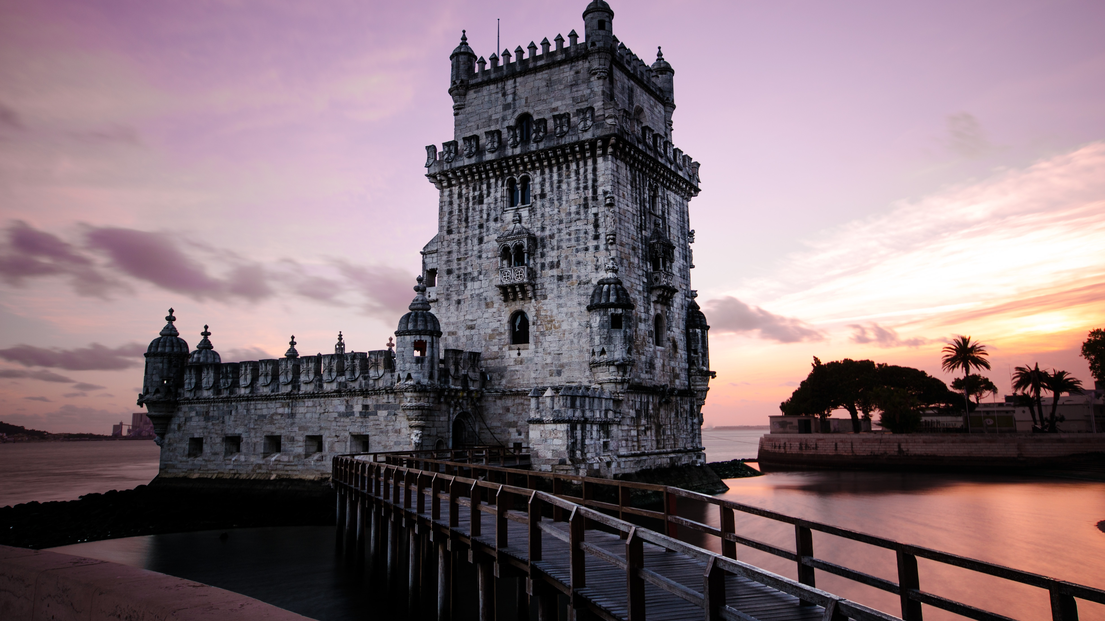
Java 9, 8u121+

Slide 46
Java 9, 8u121+
CPU configuration:
-XX:ParallelGCThreads and -XX:CICompilerCount are set based on Containers CPU limits (can be overridden)
calculated from --cpuset-cpus
Memory Configuration:
-XX:+UnlockExperimentalVMOptions
-XX:+UseCGroupMemoryLimitForHeap
set -XX:MaxRAMFraction to 2 (default is 4)

Slide 47
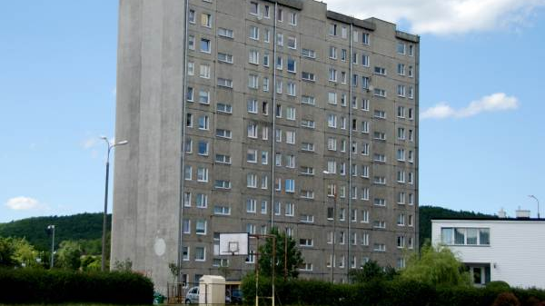
Java 10+, 8u191+

Slide 48
Java 10+, 8u191+
More container awareness
Improve heap memory allocations [JDK-8196595]:
-XX:InitialRAMPercentage, -XX:MaxRAMPercentage, and -XX:MinRAMPercentage
-XX:InitialRAMFraction, -XX:MaxRAMFraction, and -XX:MinRAMFraction are Deprecated
The total number of CPUs available to the Java process is calculated from --cpus, --cpu-shares, --cpu-quota [JDK-8146115]
Use -XX:-UseContainerSupport to return to the old behavior
# processors that the JVM will use internally -XX:ActiveProcessorCount
Attach in linux became be relative to /proc/pid/root and namespace aware (jcmd, jstack, etc)

Slide 49

Java 11+

Slide 50
Java 11+
More container awareness
Removes -XX:+UnlockExperimentalVMOptions, -XX:+UseCGroupMemoryLimitForHeap [JDK-8194086]
jcmd -l and jps commands do not list JVMs in Docker containers [JDK-8193710]
Container Metrics (-XshowSettings:system) [JDK-8204107]
Update CPU count algorithm when both cpu shares and quotas are used [JDK-8197867]
-XX:+PreferContainerQuotaForCPUCount

Slide 51
Java Ergonomics Summary
If you really can’t change the Java version in your docker to modern one – User Fabric8 Script to run your app
If you can
Start with java 11
or at least 8u191+

Slide 52

Security

Slide 53
Security in Containers
Know what in your container
Vulnerability scanning (Docker EE, Microscanner, Clair, ...)
Docker Content Trust
Minimal container OS (Minimal attack surface)
Monitoring & Auditing

Slide 54
Security in Containers
Least privilege:
Change USER
Read-only filesystems
Limit resources

Slide 55
Our Dockerfile 6
FROM openjdk:8-jdk-alpine as build
WORKDIR /workspace/users-app
COPY mvnw .
COPY .mvn .mvn
COPY pom.xml .
COPY src src
RUN ./mvnw install -DskipTests
RUN mkdir -p target/dependency && (cd target/dependency; jar -xf ../*.jar)
FROM openjdk:8-jre-alpine
RUN addgroup -S app && adduser -S -G app app
USER app
RUN mkdir -p /home/app/users-app
ARG DEPENDENCY=/workspace/users-app/target/dependency
COPY --from=build ${DEPENDENCY}/BOOT-INF/lib /home/app/users-app/users-app/lib
COPY --from=build ${DEPENDENCY}/META-INF /home/app/users-app/users-app/META-INF
COPY --from=build ${DEPENDENCY}/BOOT-INF/classes /home/app/users-app/users-app
ENTRYPOINT [ "java", \
"-XshowSettings:VM", \
"-XX:NativeMemoryTracking=summary", \
"-cp", "/home/app/users-app/users-app:/home/app/users-app/users-app/lib/*", \
"com.example.users.UsersApp"]
Magic

Slide 56
Clair

Slide 57
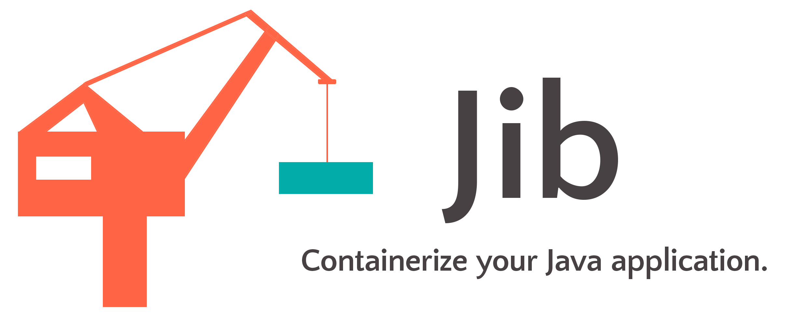
Google JIB

Slide 58
Google JIB
Fast - Deploy your changes fast. Jib separates your application into multiple layers, splitting dependencies from classes. Now you don’t have to wait for Docker to rebuild your entire Java application - just deploy the layers that changed.
Reproducible - Rebuilding your container image with the same contents always generates the same image. Never trigger an unnecessary update again.
Daemonless - Reduce your CLI dependencies. Build your Docker image from within Maven or Gradle and push to any registry of your choice. No more writing Dockerfiles and calling docker build/push.

Slide 59
Google JIB
Maven plugin
<build>
<plugins>
<plugin>
<groupId>com.google.cloud.tools</groupId>
<artifactId>jib-maven-plugin</artifactId>
<version>1.6.1</version>
<configuration>
<to>docker.io/mateuszdyminski/users-app:${env.DOCKERFILE_VERSION}</to>
</configuration>
</plugin>
</plugins>
</build>

Slide 60
Google JIB – the magic inside:
FROM gcr.io/distroless/java
COPY target/dependencies /app/dependencies
COPY target/resources /app/resources
COPY target/classes /app/classes
ENTRYPOINT java -cp /app/dependencies/*:/app/resources:/app/classes my.app.Main

Slide 61

Extras

Slide 62
Java Modules

Slide 63
Faster Startup

Slide 64
GraalVM

Slide 65

Summary

Slide 66
Takeaways
If you run your app in container use Java 11 (or at least 8u191+)
Remember about the security

Slide 67
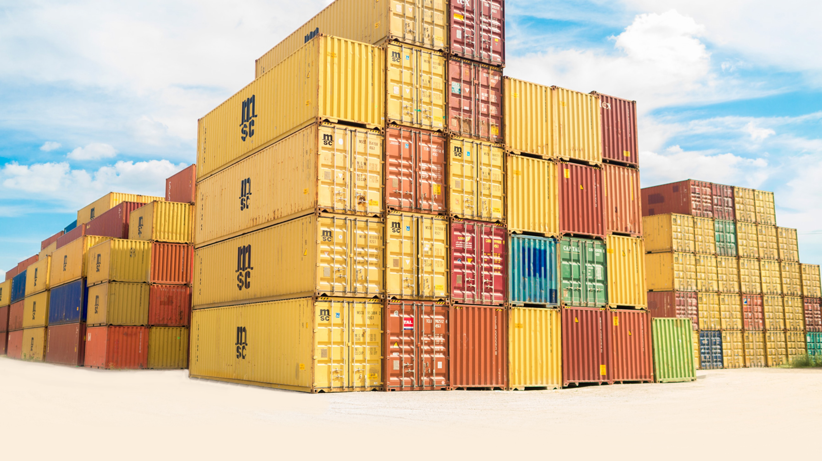
Hopefully your containers would look like

Slide 68

Not like

Slide 69
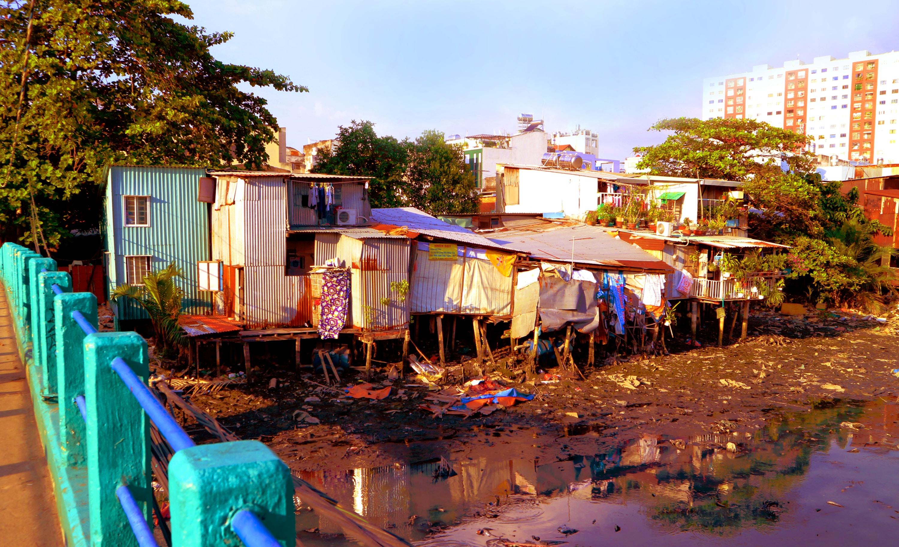
Not like

Slide 70

Not like

Slide 71

Q&A

